Slide 1

Generative AI and Applications
Course Code: 25CS60TP1378-3
L:3 Hrs, P: 2 Hr, Per Week Total Credits:4
Department of Computer Science and Applications
By Dr. Suhashini Chaurasia

Slide 2
Unit-II
Neural Language Models, CNN, RNN, LSTM, GRU, Encoder-Decoder Architecture, Problems in encoder-decoder architecture.

Slide 3
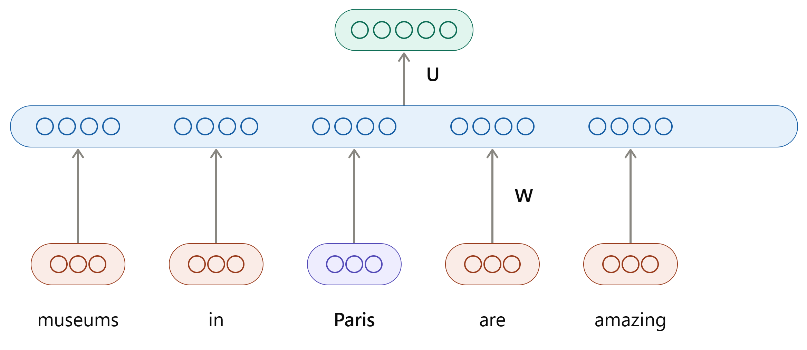
Neural Language Models
Input: Sequence of words x⁽¹⁾, x⁽²⁾,…,x^{(t)}
Output: Probability distribution of the next word P(x^{(t+1)}|x^{(t)}, ….,x⁽¹⁾)

Slide 4
Neural Language Models
}
}
The proctor started the clock the students opened their __________
Discard Fixed window

Slide 5
Challenges/ Problems/ limitations of language modelling
Uses statistical modelling
Probability is calculated in the outer layer
Unknown word probability can’t be computed
Bigram matrix is sparse i.e. contain more number of zeros

Slide 6
Convolutional Neural Network (CNN)
Widely used in image processing and Computer vision tasks.
Contributed in NLP too.
CNN –
  Like traditional NN – neuron having weights and biases (i.e. kernel)
  Neuron – receive i/p; perform dot product; apply activation function; convolution o/p pooled to get a final representation (calculate score/ loss).

Slide 7
CNN
The convolution function is:
  It extracts n-gram context in a sentence by moving a feature extractor over a sliding window.
  Then pool the results.
Sentence is represented as a matrix of word embeddings.
Filter captures local dependencies within the text (phrase / short sentences are crucial for understanding the context and meaning).

Slide 8
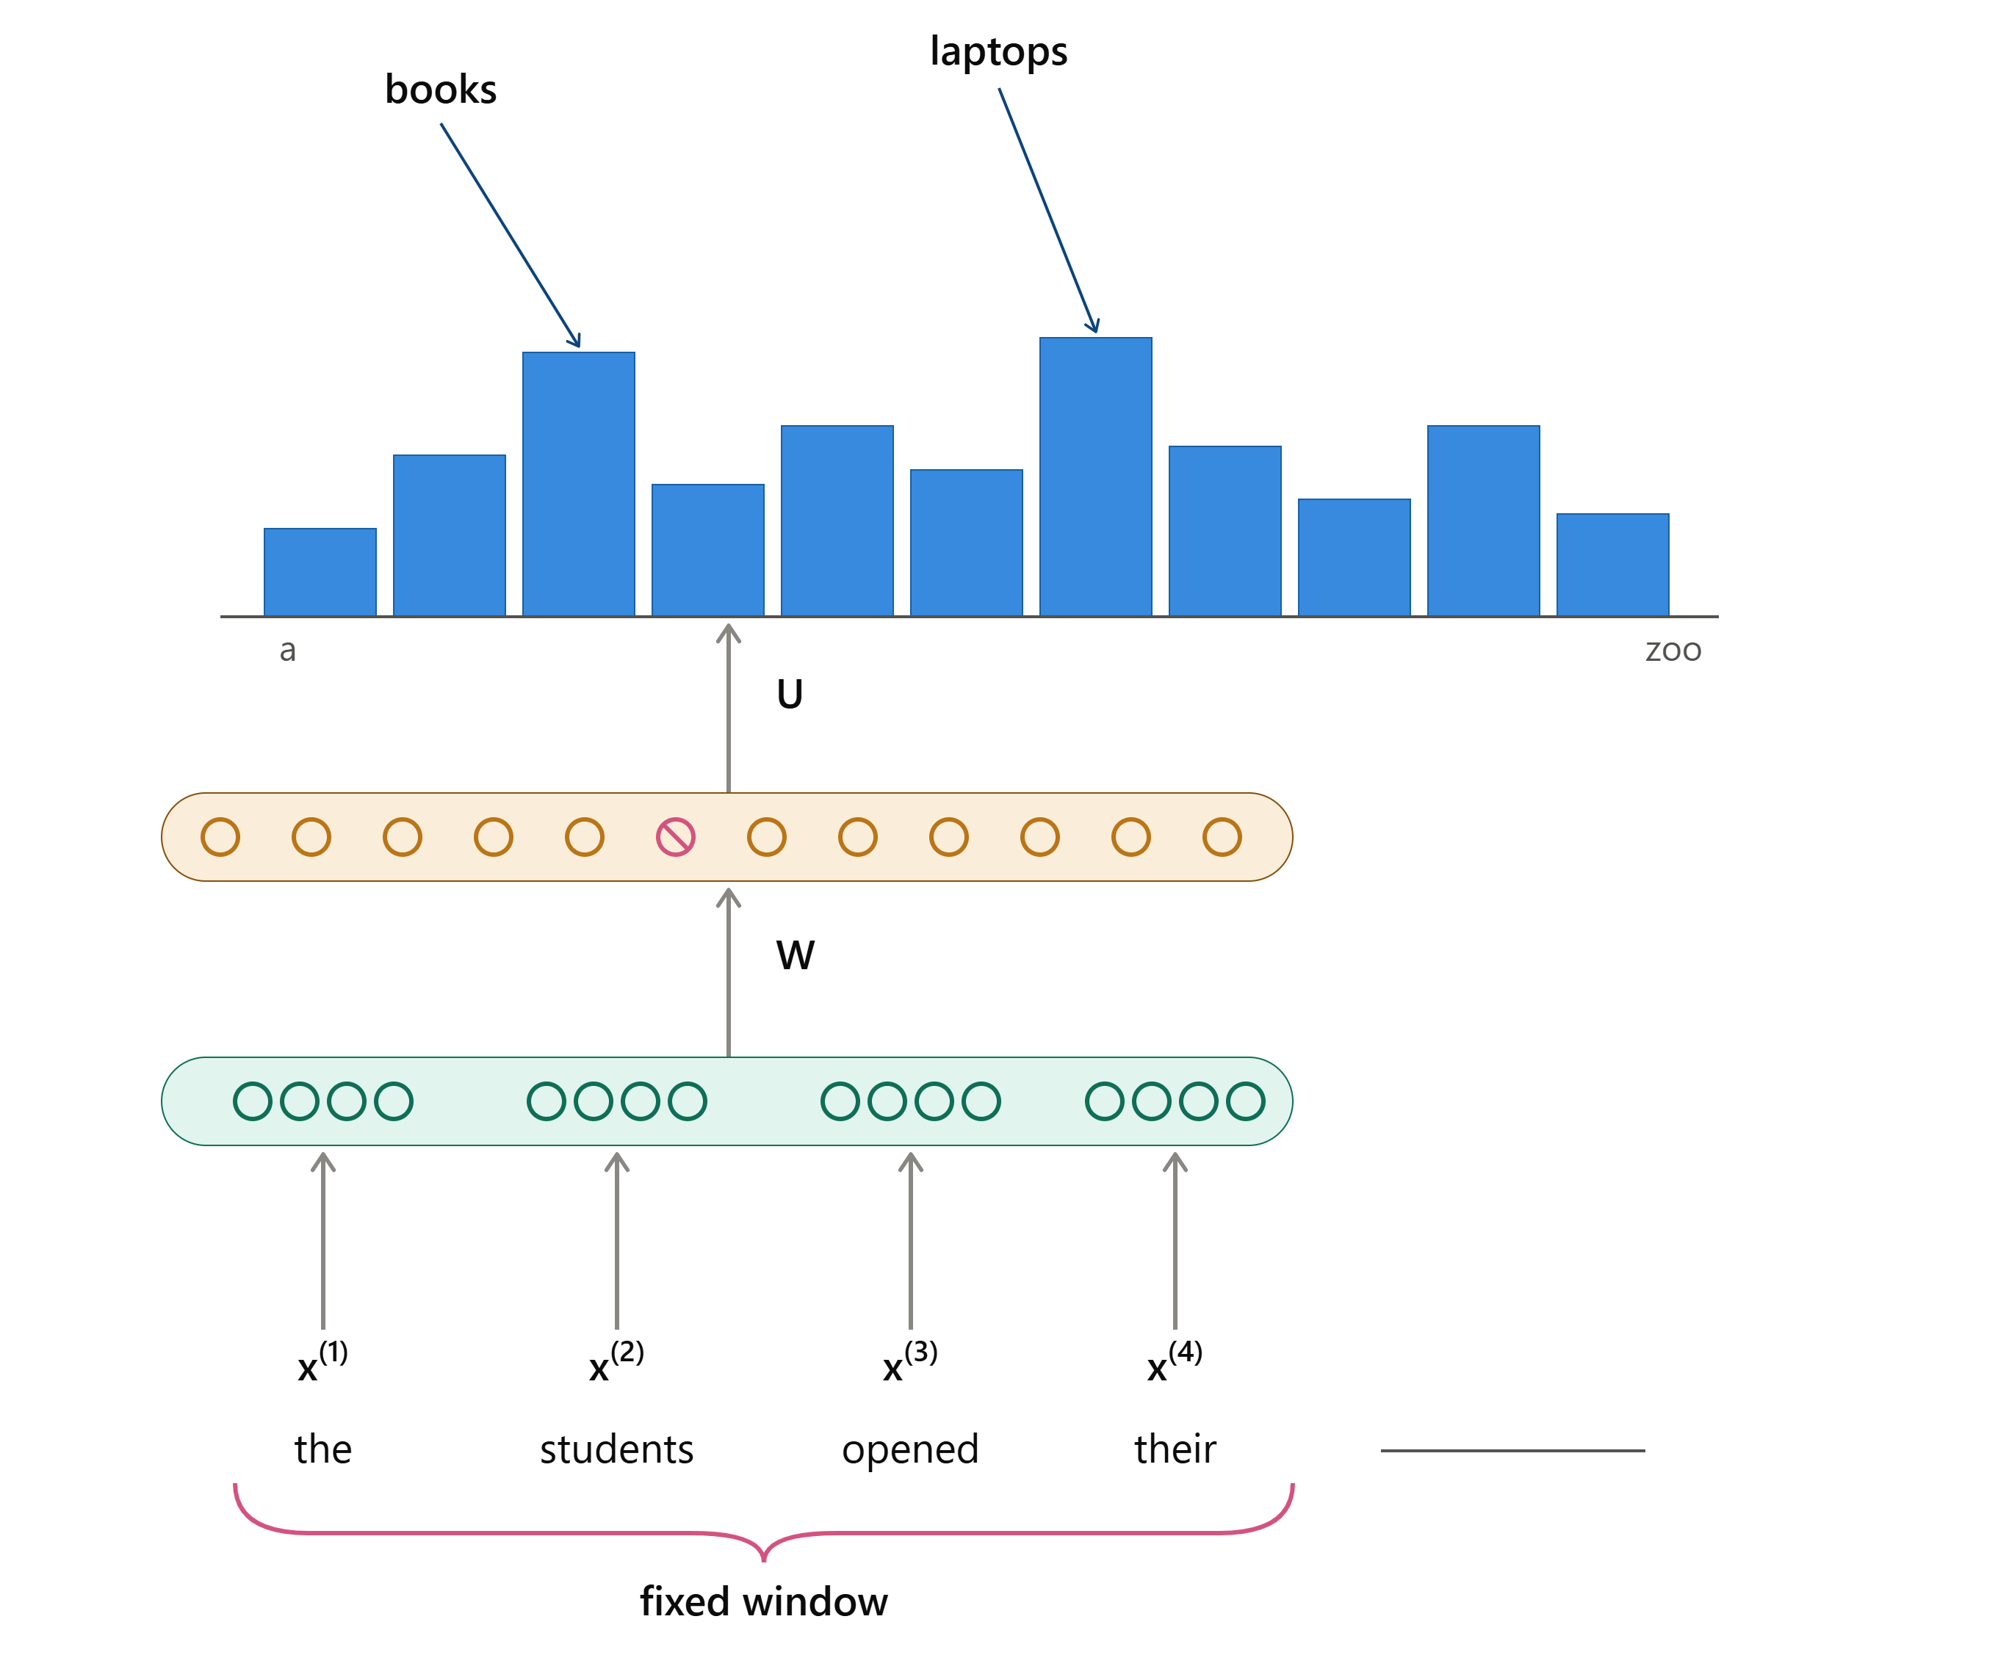
CNN: Fixed window Neural Language Model
Output distribution
ŷ=SoftMax(Uh+b₂)
Hidden layer
h=f(We+b₁)
Concatenated word embeddings
e=e⁽¹⁾;e⁽²⁾;e⁽³⁾;e⁽⁴⁾
Words/one-hot vectors
x⁽¹⁾,x⁽²⁾,x⁽³⁾,x⁽⁴⁾

Slide 9
CNN: Fixed window Neural Language Model
Improvements over n-gram LM
No sparsity problem
Don’t need to store all observed n-grams. n-gram predicts the next word based on previous n-1 words
NLM learns the parametersto predict subsequent word.
Hence, it manages and utilises longer contextual sequences effectively.
Problem with Neural Language Model
Fixed window is too small
Enlarging window enlarges W
x⁽¹⁾ and x⁽²⁾ are multiplied by completely different weights in W
No symmetry in how the inputs are processed

Slide 10
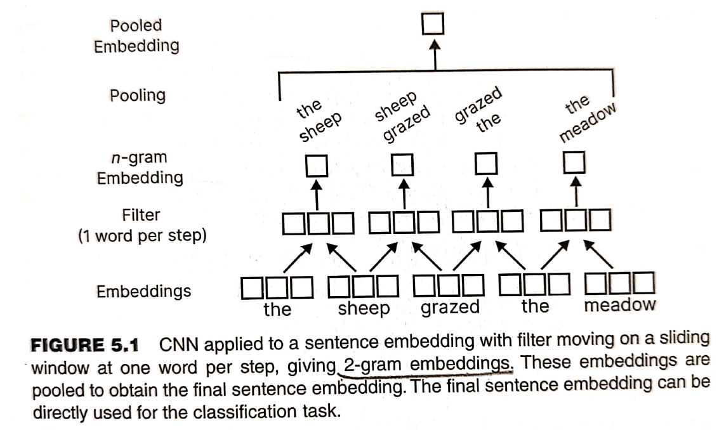

Slide 11
Components of CNN
Kernel
Stride
Pooling
Padding

Slide 12
Kernel or filter
Similar to weights in NN that learn features from data
Kernel slides over input text (i.e. embedded matrix)
Detects patterns by performing a convolution operation
Kernel size: depends upon n-gram and embedding vector dimension
  E.g.: to capture 2-gram context and each word embedding vector of size 5, the kernel size = 2*5 = 10
Increasing the kernel size allows CNN to capture more context and patterns
Stacking multiple convolutions increases feature complexity; empowering CNN

Slide 13
Stride
It is the number of tokens (words or characters) the convolution filter moves ahead at each step.
It decides how many tokens are skipped while scanning a sentence.
Example- Sentence: “I love natural language processing”
Filter size = 3 (trigram)
Stride = 1: Filter moves one word at a time
  Captures:
    I love natural
    love natural language
    natural language processing
Stride = 2: Filter moves two words at a time
  Captures:
    I love natural
    natural language processing

Slide 14
Effect of Stride
Small stride (1)
  Captures fine-grained local patterns
  Better for sentiment, NER, text classification
Large stride (>1)
  Faster computation
  May miss important word relationships or semantics.
Stride equal to n-gram selected means filter completely skips over n-gram context captured in the previous step.

Slide 15
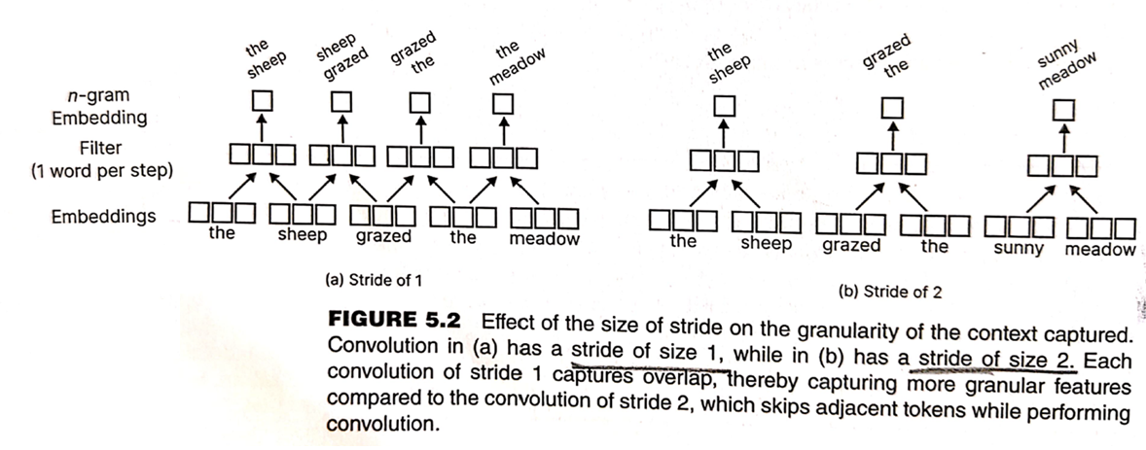

Slide 16
Pooling
Applied after the convolution operation, to combine vectors into single vector for scoring, loss computation, and then prediction.
Types of Pooling:
  Max Pooling
  Min Pooling
  Average Pooling

Slide 17
Given following two vectors A and B.
A = [0.2, -0.1, 0.4, 0.5] and B = [0.4, 0.3, -0.7, 0.8]
Calculate maximum, minimum and average pooling.
Max pooling selects the maximum value from the corresponding indices of vectors A and B.
max = [0.4, 0.3, 0.4, 0.8]
Min pooling selects the minimum value from the corresponding indices of vectors A and B.
min = [0.2, -0.1, -0.7, 0.5]
Average pooling calculates the average of the corresponding indices of vectors A and B.
avg = [0.3, 0.1, -0.15, 0.65]

Slide 18
Padding
To manage tokens of varying lengths add extra zeros around the input data (i.e. sentence) before applying convolution.
Ensures that –
  the lengths of sequences (sentences) are the same
  as well as sliding windows have sufficient tokens to perform convolution.
E.g: Sentence “I love natural language processing”
Tokens: [I, love, natural, language, processing]; Input Length = 5
Assume: Filter size = 3 and Stride = 1
Case 1: WITHOUT Padding (Valid Padding)
Convolution windows:
  I love natural
  love natural language
  natural language processing
Output size = 3
Edge words have less influence

Slide 19
Padding cont…
Case 2: WITH Padding (Same Padding)
Add 1 padding token on both sides:
  [PAD, I, love, natural, language, processing, PAD]
Convolution windows:
  PAD I love
  I love natural
  love natural language
  natural language processing
  language processing PAD
Output size = 5 (same as input) ?
What Padding Achieves - Keeps output length the same as input.
Input length = number of words (tokens) in the sentence.
Output length = number of feature values produced after convolution.
Prevents feature loss at boundaries, and
Allows deeper CNN architectures (stable network design) in NLP.

Slide 20
CNN Variations
Hierarchical Convolutions
Dilated Convolutions

Slide 21
Hierarchical Convolutions
Use of multiple stacked convolutional layers - Each layer learns features at a different level of abstraction.
Lower convolution layers capture local patterns such as character-level or n-grams (bigrams, trigrams) words.
Intermediate layers combine these local features to learn phrase-level representations.
Higher layers encode global semantic information of the sentence or document.
Stride is always 1.

Slide 22
Dilated Convolutions
Extension of Hierarchical convolution
Stride for each layer exceeds 1
  A dilation rate determines the spacing between kernel elements.
Exponentially increase the context under focus with fewer stacked layers.
  Allows the model to capture long-range dependencies without increasing model depth or parameter count. (i.e. to view distant tokens in a single convolution)
Avoids excessive stacking of layers, improving computational efficiency.

Slide 23
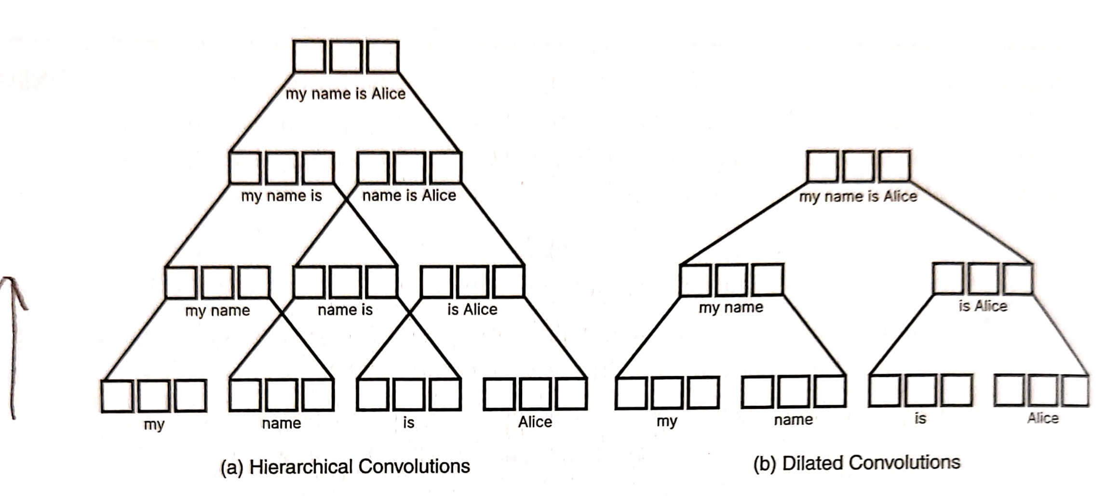

Slide 24
Consider 21 tokens and a convolution of size 3
Hierarchical convolution:
  Generate 19 tokens in first layer.
  Reduces 2 tokens per layer.
  Generates 10 layers to reduce it to single token.
Dilated Convolution:
  In the first layer, generate 10 tokens plus last token along with zero padding creates 1 token. Thus 11 tokens in the first layer.
  With 4 layers, it final single token.

Slide 25
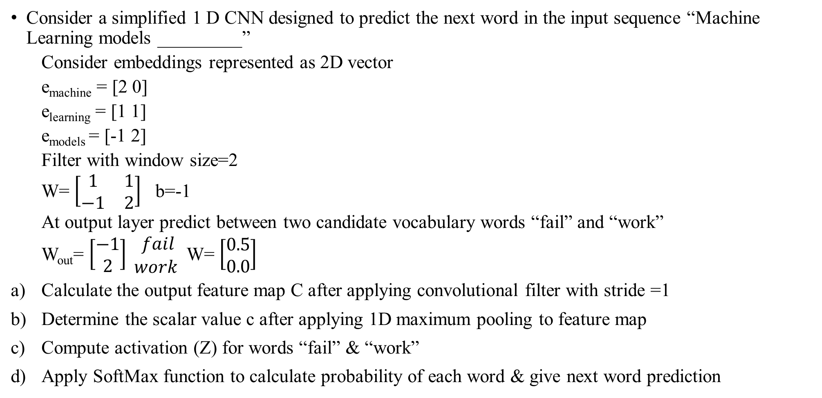
Problem based on CNN: next word prediction
Consider a simplified 1 D CNN designed to predict the next word in the input sequence “Machine Learning models _________”
  Consider embeddings represented as 2D vector
  e_{machine} = [2 0]
  e_{learning} = [1 1]
  e_{models} = [-1 2]
  Filter with window size=2
  W= $\left[\begin{matrix}1 & 1 \\ −1 & 2\end{matrix}\right]$ b=-1
  At output layer predict between two candidate vocabulary words “fail” and “work”
  W_{out}= $\left[\begin{matrix}−1 \\ 2\end{matrix}\right] \begin{matrix}fail \\ work \end{matrix}$ W= $\left[\begin{matrix}0.5 \\ 0.0\end{matrix}\right]$
Calculate the output feature map C after applying convolutional filter with stride =1
Determine the scalar value c after applying 1D maximum pooling to feature map
Compute activation (Z) for words “fail” & “work”
Apply SoftMax function to calculate probability of each word & give next word prediction

Slide 26
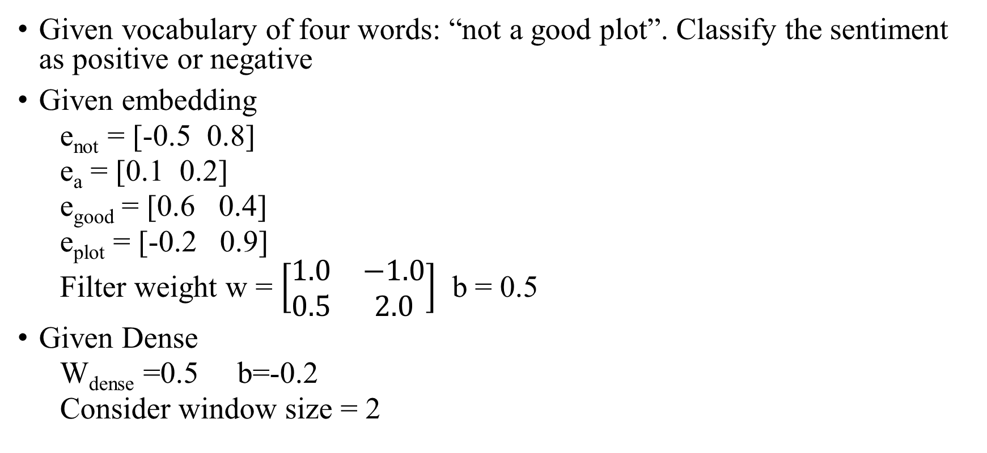
Problem based on CNN: Sentiment analysis
Given vocabulary of four words: “not a good plot”. Classify the sentiment as positive or negative
Given embedding
  e_{not} = [-0.5 0.8]
  e_{a} = [0.1 0.2]
  e_{good} = [0.6 0.4]
  e_{plot} = [-0.2 0.9]
  Filter weight w = $\left[\begin{matrix}1.0 & −1.0 \\ 0.5 & 2.0\end{matrix}\right]$ b = 0.5
Given Dense
  W_{dense} =0.5 b=-0.2
  Consider window size = 2

Slide 27
Challenges /Limitations/ problems with CNN
Fixed window size, so not able to capture infinite length
As size of window increases, the dimension of weight w will increase
First column dependency on e1, second column on e2 and so on.

Slide 28
Recurrent Neural Networks (RNN)
Designed to process sequential data by maintaining a hidden state that captures information from previous time steps
At each step, the current input and the previous hidden state are combined to produce the new hidden state
  Enables the model to learn temporal (earlier inputs influence later outputs) and contextual dependencies.
RNNs capture temporal dependencies by processing sequences step-by-step, whereas CNNs capture local patterns using fixed-size filters applied in parallel

Slide 29
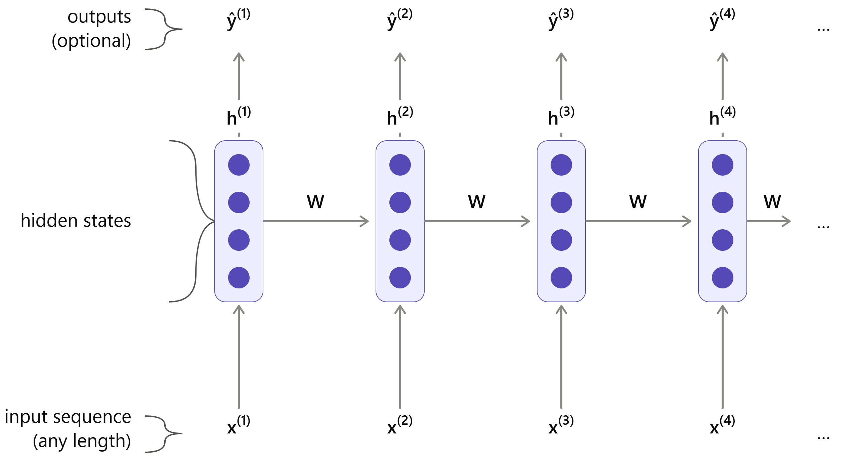
Recurrent Neural Networks (RNN)
h⁽⁰⁾
W
e⁽²⁾
e⁽³⁾
e⁽⁴⁾
e⁽¹⁾

Slide 30
Hidden State Update
Each word updates the hidden state
Hidden state Update equation is :
h^{(t)}=tanh(W_{h}h^{(t-1)}+W_{e}e^{(t)}+b₁)
where:
h^{(t)} : hidden state at time step t
h^{(t-1)} : hidden state at time step t-1
W_{e}: input-to-hidden weight matrix
e^{(t)}: word embedding
b₁ : bias

Slide 31
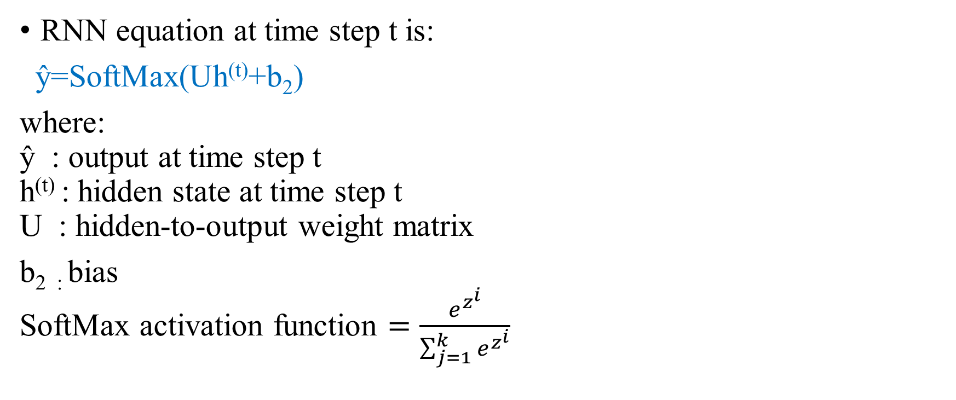
RNN Output Equation
RNN equation at time step t is:
ŷ=SoftMax(Uh^{(t)}+b₂)
where:
ŷ : output at time step t
h^{(t)} : hidden state at time step t
U : hidden-to-output weight matrix
b_{2 :} bias
SoftMax activation function $=\frac{e^{z^{i}}}{\sum_{j=1}^{k}{e^{z^{i}}}}$

Slide 32
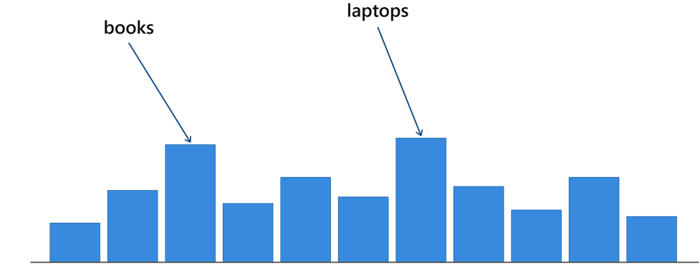
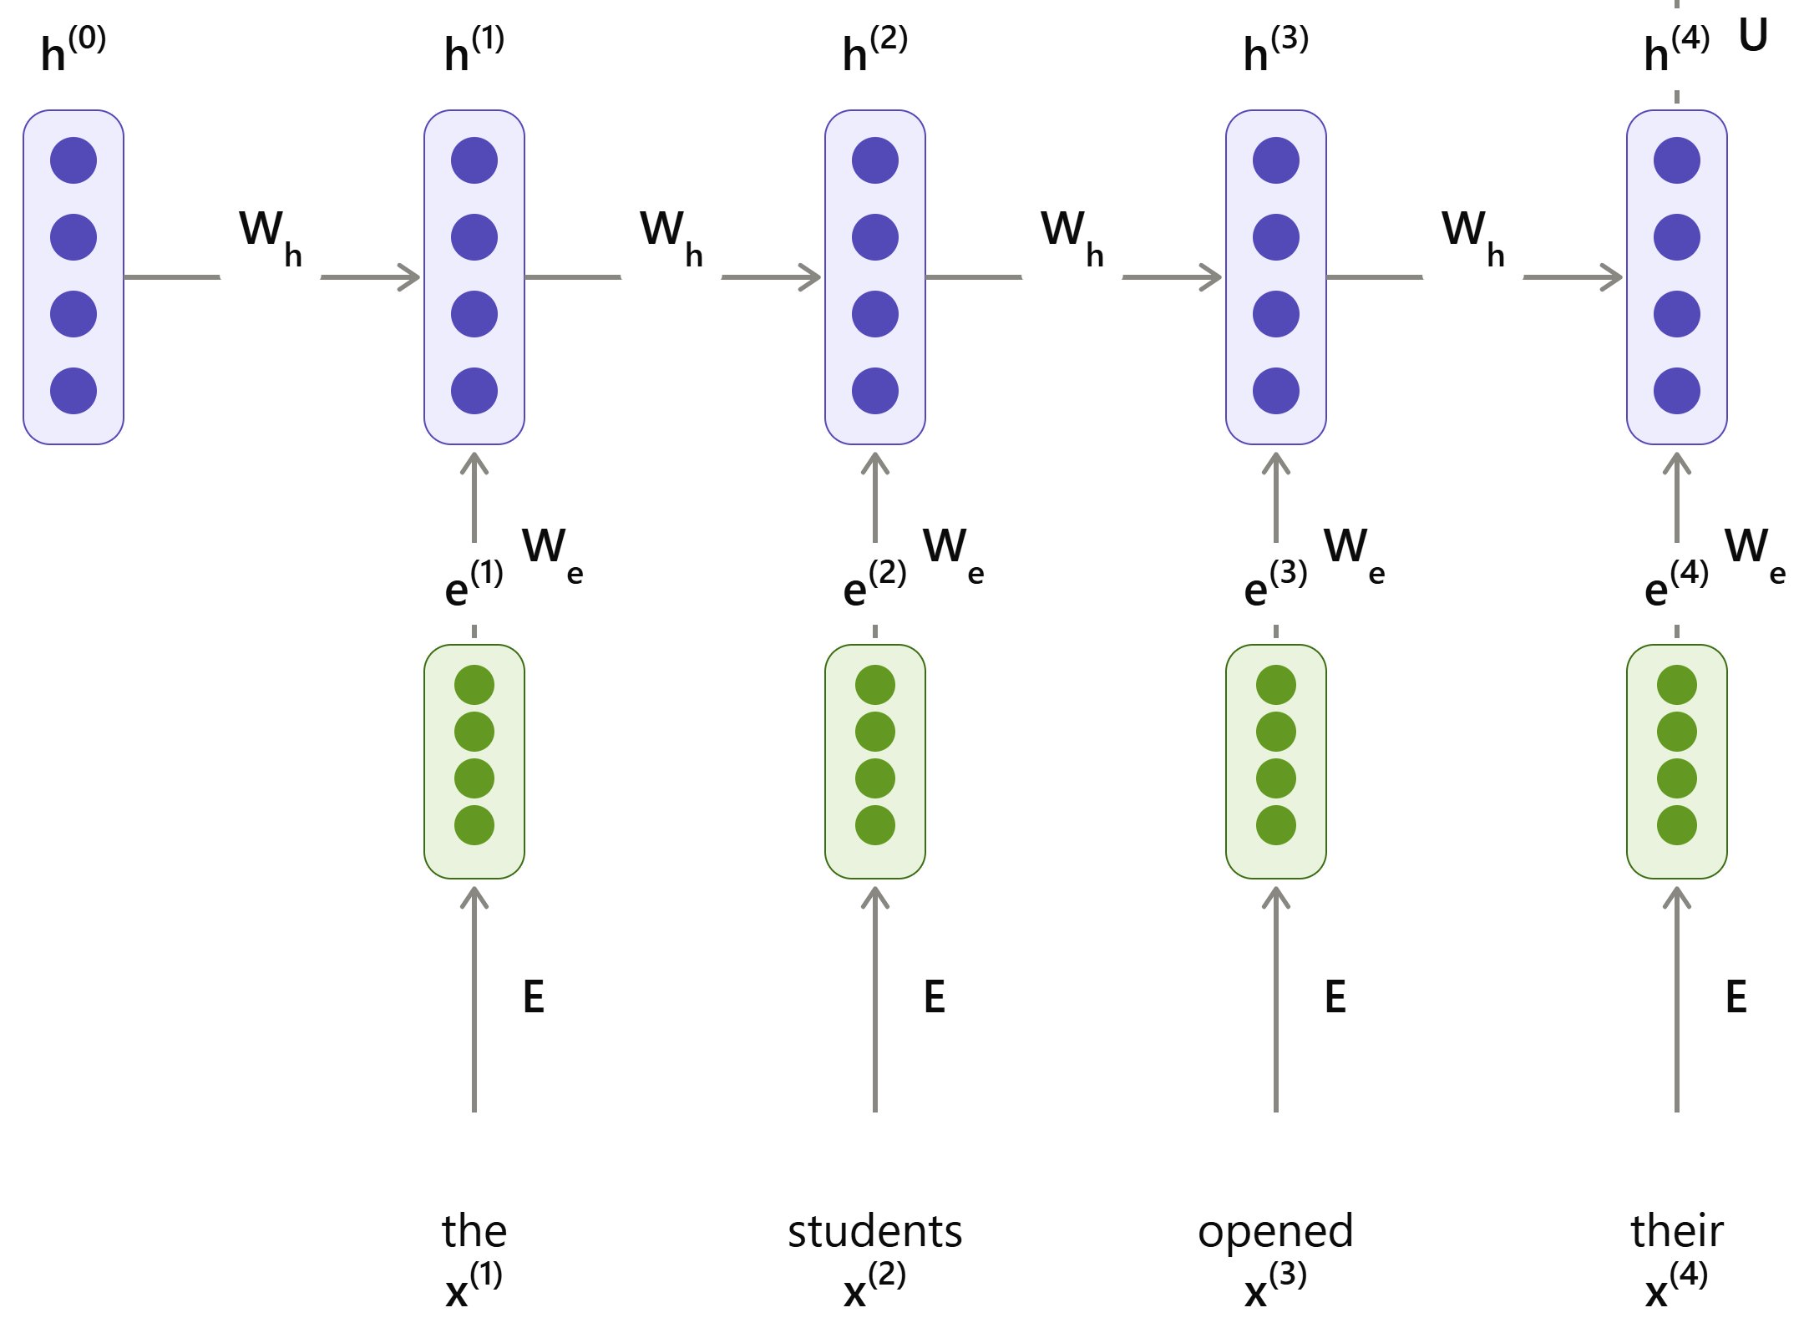
RNN language Model
output distribution
ŷ=SoftMax(Uh^{(t)}+b₂)
hidden layer
h^{(t)}=tanh(W_{h}h^{(t-1)}+W_{e}e^{(t)}+b₁)
h⁽⁰⁾ is the initial hidden layer
word embeddings/ one hot encoding e^{(t)}
words x^{(t)}

Slide 33
RNN Example: Input Sentence "my name is alice"
After tokenization:
x₁ = my, x₂ = name, x₃ = is, x₄ = alice
Each word is converted into a vector (embedding) e₁ = x₁ , e₂ = x₂, e₃ = x₃, e₄ = x₄
RNN Processing (Time Steps)
At t = 1:
h₁ = tanh(W_{e} e₁ + Wₕ h₀ + b₁)
Learns context from “my”
At t = 2:
h₂ = tanh(W_{e} e₂ + Wₕ h₁ + b₁)
Now knows “my name”
At t = 3:
h₃ = tanh(W_{e}e₃ + Wₕ h₂ + b₁)
Context becomes “my name is”
At t = 4:
h₄ = tanh(W_{e}e₄ + Wₕ h₃ + b₁)
Full meaning: “my name is alice”
Output
If the task is next-word prediction:
ŷ = SoftMax(Uh₄ + b₂)
Where
x₁, x₂, x₃, x₄ are input word
e₁, e₂, e₃, e₄ are word embeddings
W_{e} Weight used for embedding
W_{h} Weight used for hidden layer
b₁ bias for hidden layer
h₁, h₂, h₃,h₄ are hidden layers
U output layer weight
b₂ bias for output layer
ŷ predicted output

Slide 34
RNN language Model
RNN Advantages:
Can process any length input
Computation for step t can (in theory) use information from many steps back
Model size doesn’t increase for longer input context
Same weights applied on every timestep, so there is symmetry in how inputs are processed.
RNN Disadvantages:
Recurrent computation is slow
In practice, difficult to access information from many steps back

Slide 35
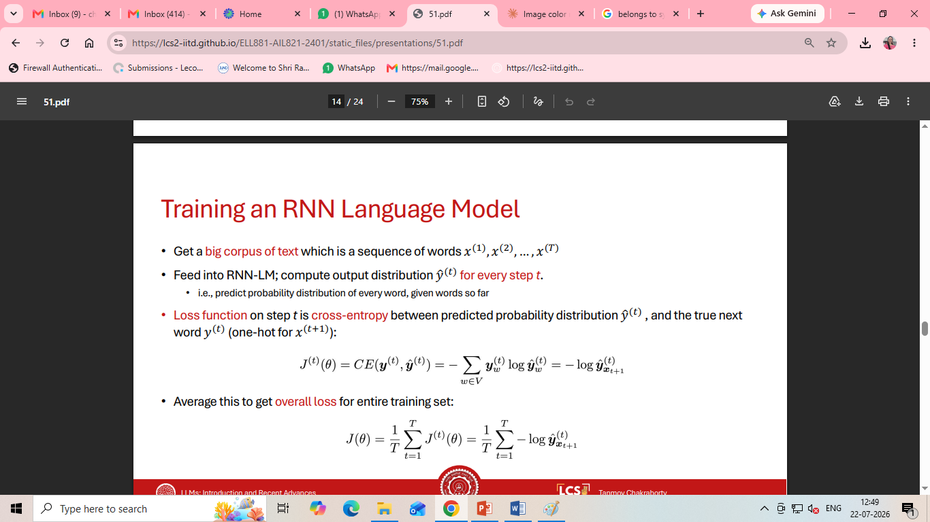
Training an RNN Language Model
Get a big corpus of text which is a sequence of words 𝑥 ⁽¹⁾ , 𝑥 ⁽²⁾ , … , 𝑥 ^{(𝑇)}
Feed into RNN-LM; compute output distribution 𝑦ො (𝑡) for every step t.
i.e., predict probability distribution of every word, given words so far
Loss function on step t is cross-entropy between predicted probability distribution ŷ ^{(𝑡)}, and the true next word 𝑦^{(𝑡)} (one-hot for 𝑥 ^{(𝑡+1)} ):
Average this to get overall losss for entire training set:

Slide 36
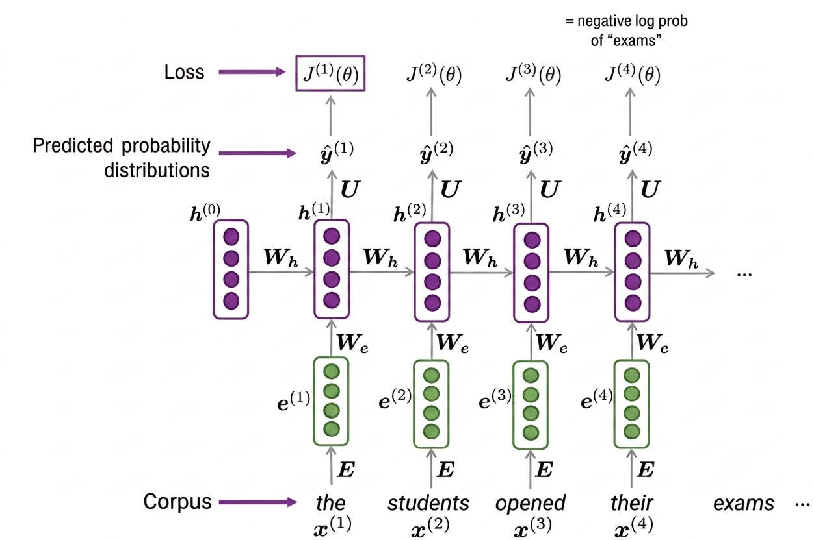

Slide 37
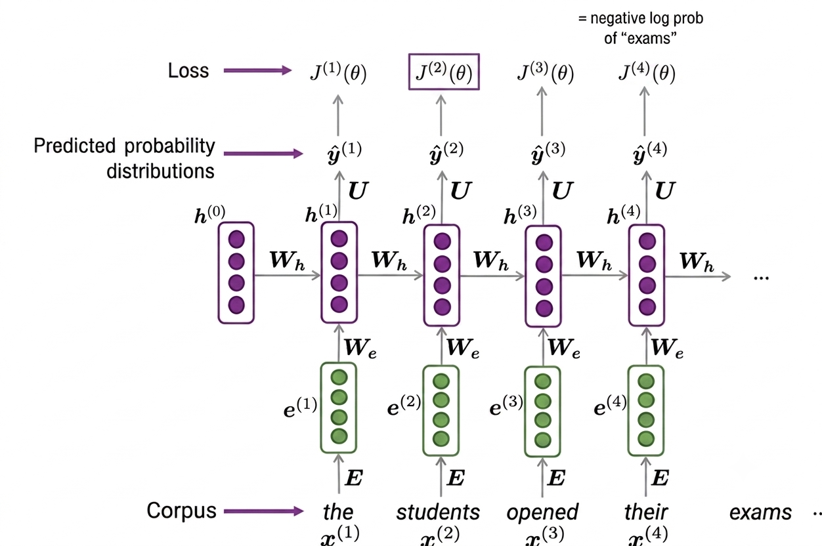

Slide 38
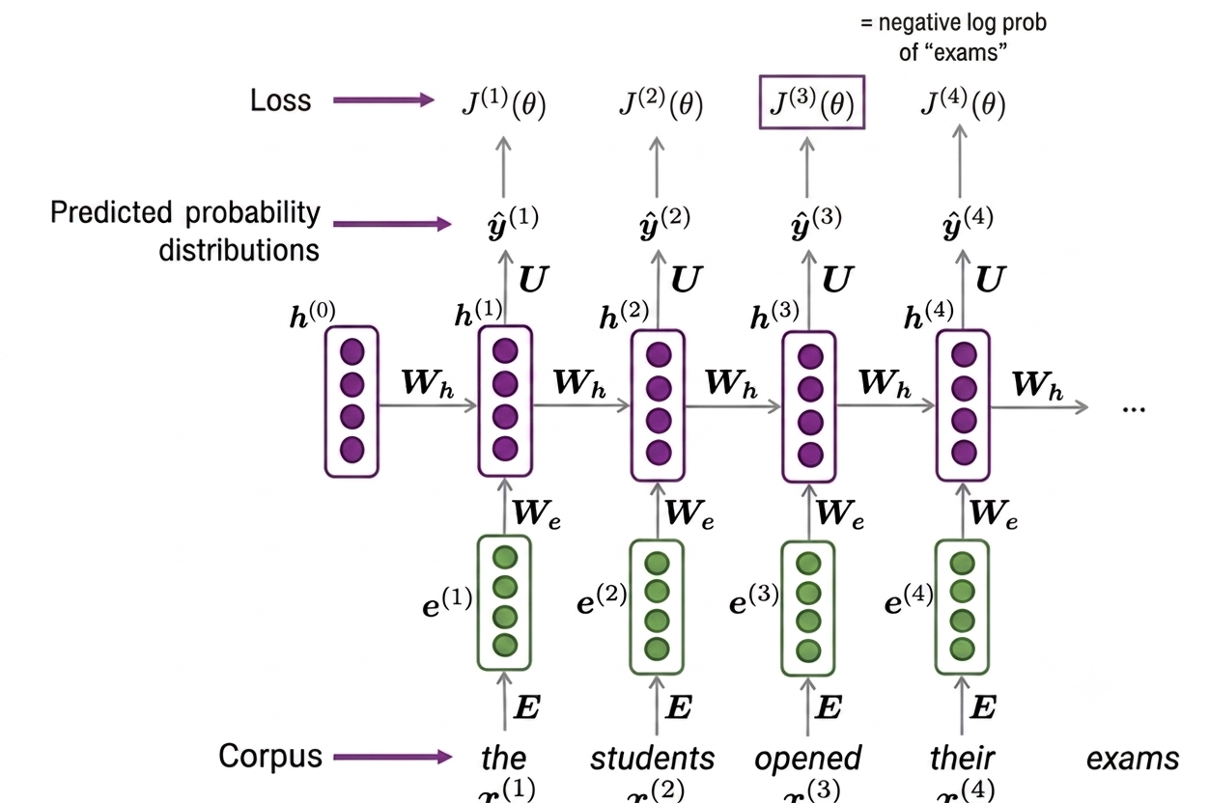

Slide 39
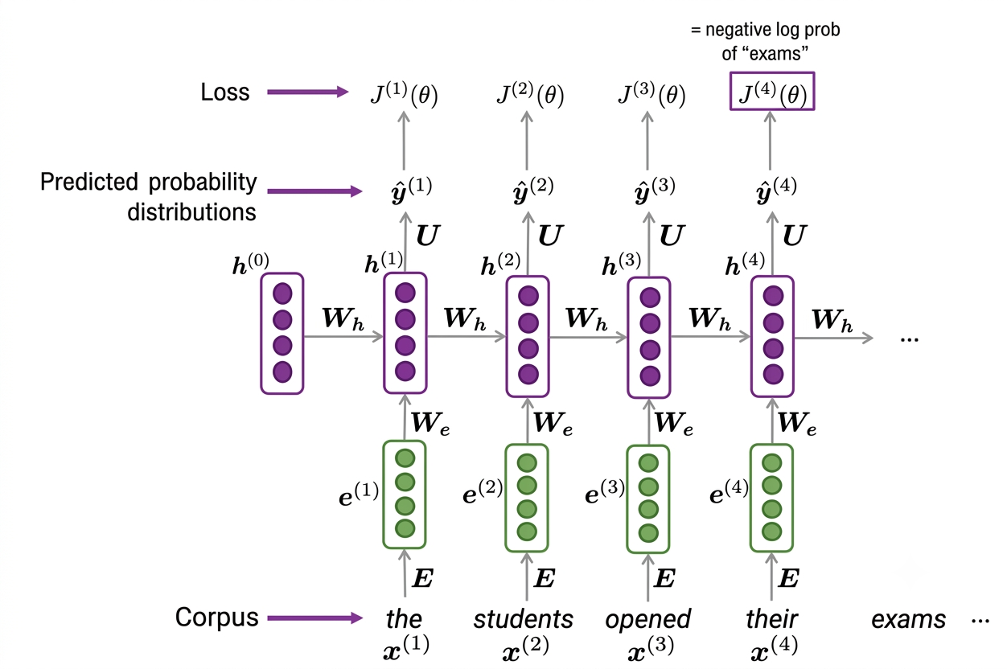

Slide 40
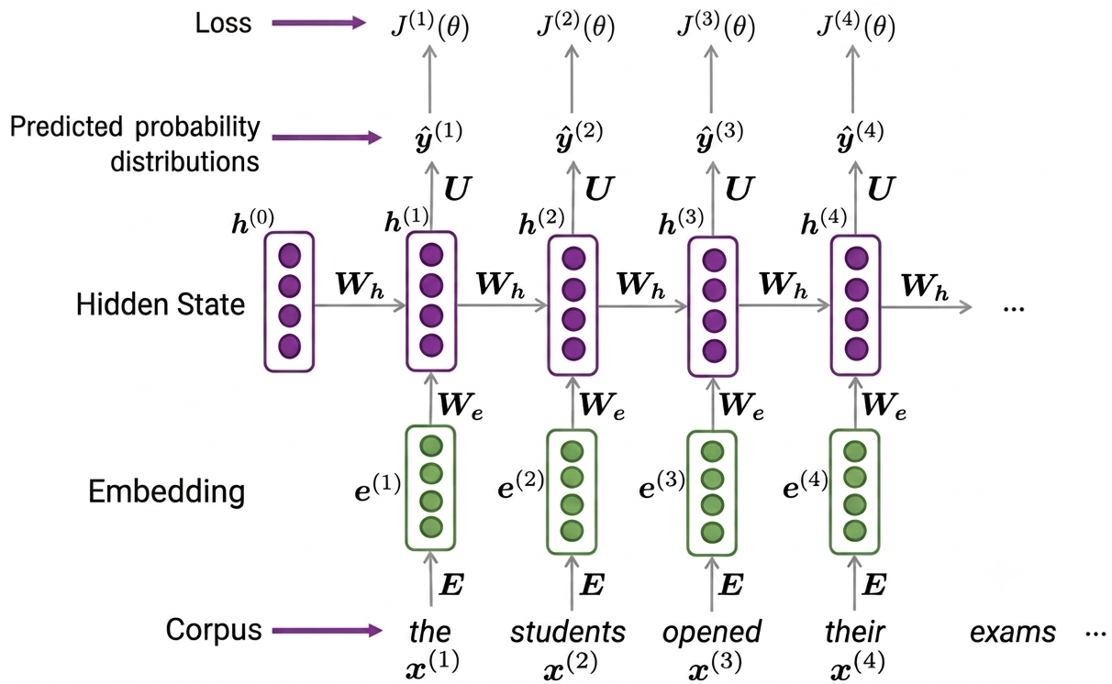
=
Teacher forcing

Slide 41
Training a RNN Language Model
Computing loss and gradients across entire corpus 𝑥⁽¹⁾ , 𝑥⁽²⁾, … , 𝑥^{(𝑇)} at once is too expensive (memory-wise)
In practice, consider 𝑥⁽¹⁾ , 𝑥⁽²⁾, … , 𝑥^{(𝑇)} as a sentence (or a document)
Recall: Stochastic Gradient Descent allows to compute loss and gradients for small chunk of data, and update
Compute loss 𝐽(𝜃) for a sentence (actually, a batch of sentences), compute gradients and update weights. Repeat on a new batch of sentences

Slide 42
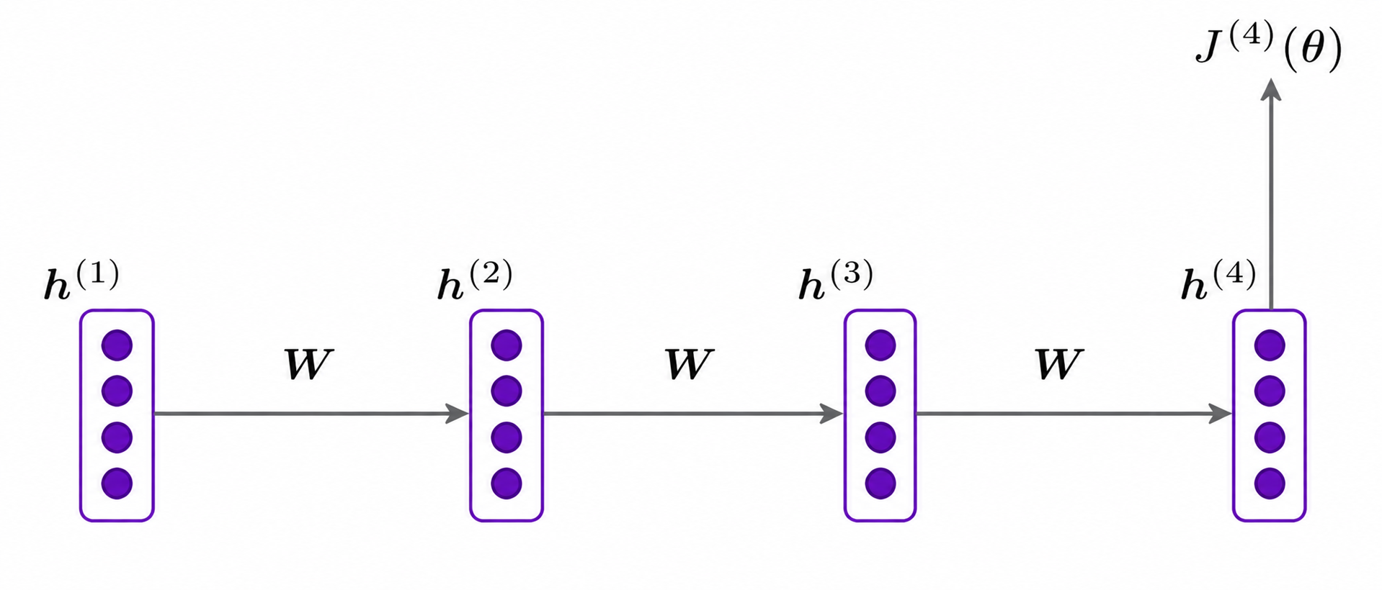
Problems with RNNs
Vanishing and Exploding Gradients

Slide 43
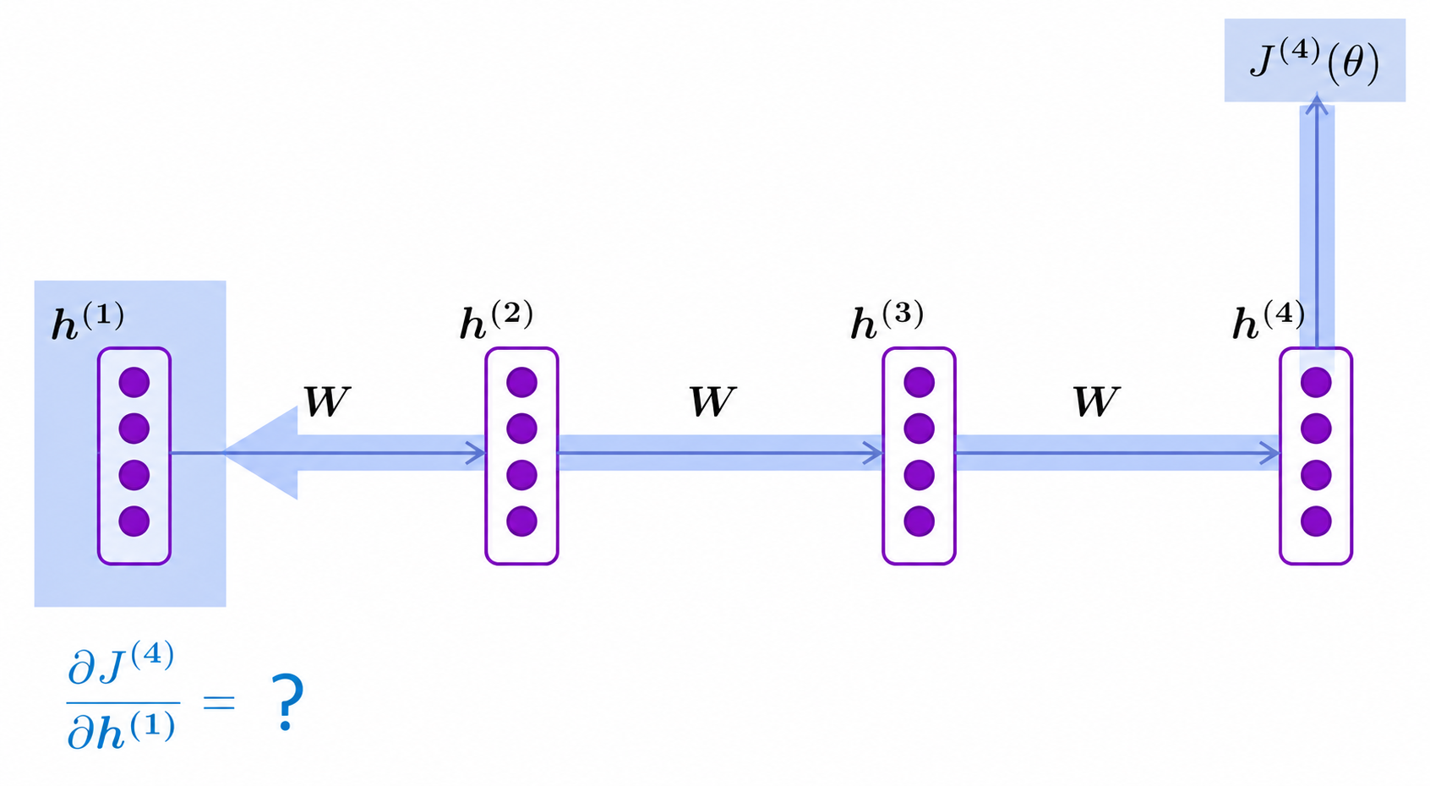

Slide 44
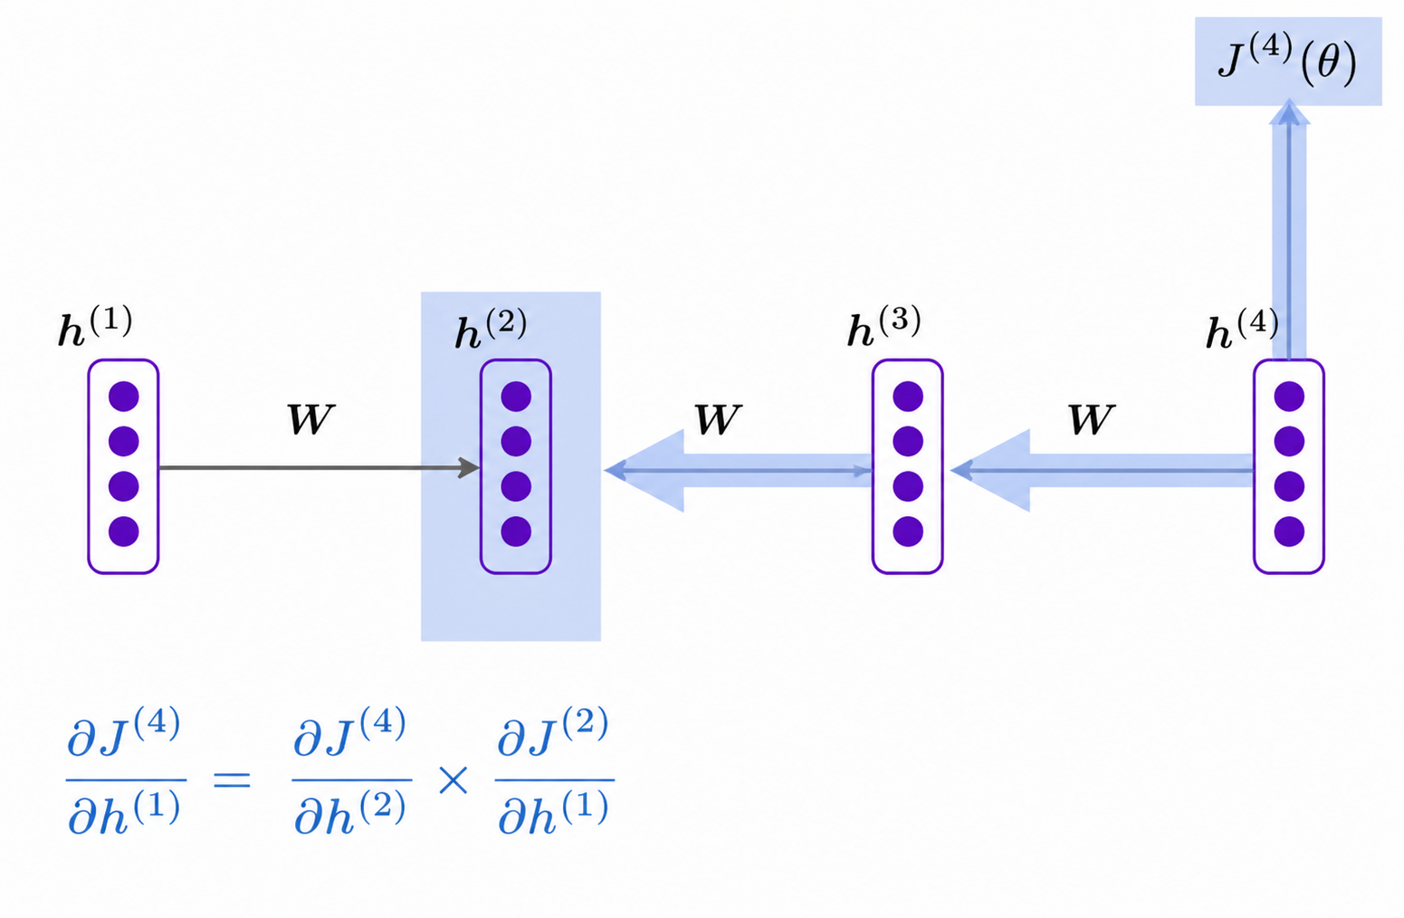
Chain Rule

Slide 45
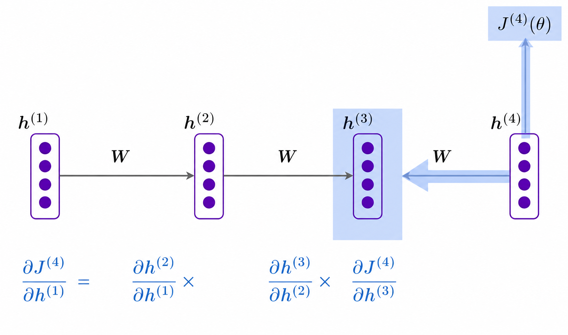
Chain Rule

Slide 46
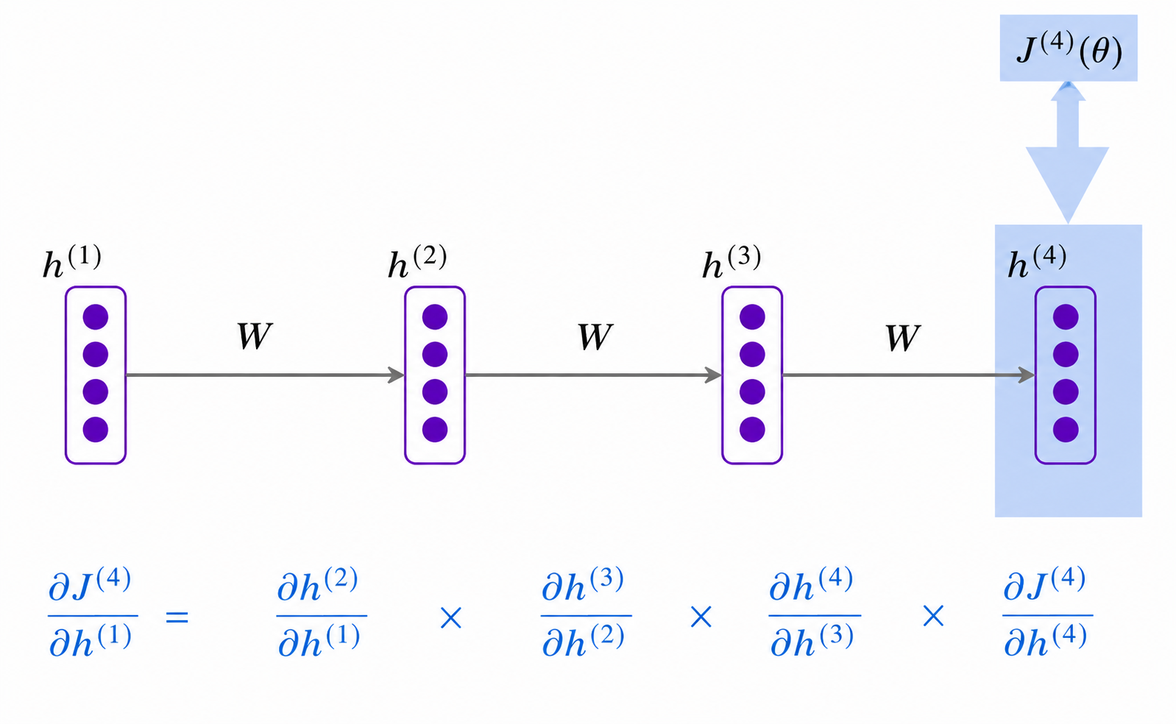
Chain Rule

Slide 47
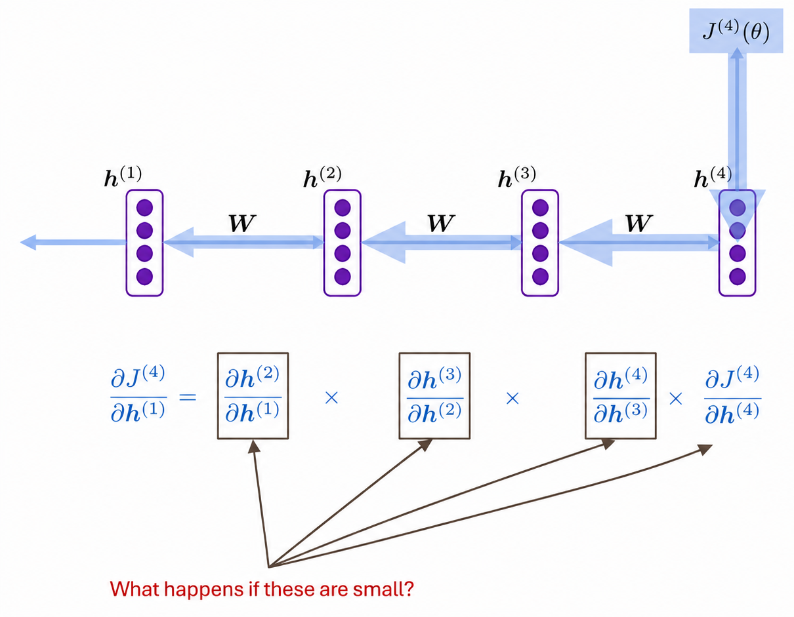

Slide 48


Now if the sequence has T tokens, then loss at time t=T is,
Next to calculate gradient of loss w.r.t. weights W_{y} :

Slide 49
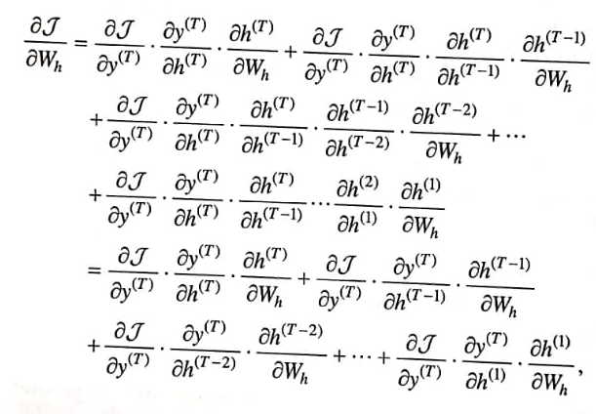
Derivatives of W_{h} and W_{x} will be computed by applying chain rule:

Slide 50
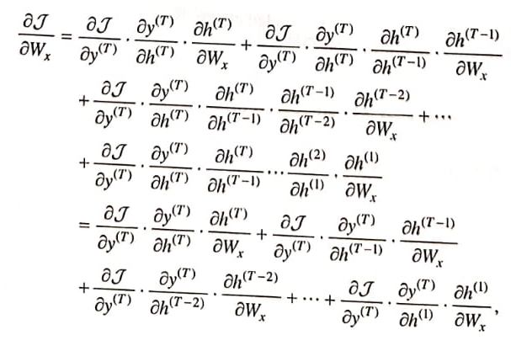

Slide 51

It is further simplified as,

Slide 52
Challenges/problems/limitations in RNN
Vanishing Gradient problem
Exploding Gradient problem

Slide 53
Vanishing Gradient problem
Gradient of loss function propagate backwards through each time step.
In this, they progressively become smaller if the repeated multiplications happen with smaller values in the time steps.
  Example: 0.5*0.2 = 0.1; 0.5*0.02 = 0.01 …
Hence, gradient from distant context diminish and become much less impactful than closer contexts.
Thus model weights are updated based on nearby context relationship.
The long-range dependencies are captured poorly.
Solution –
  Alternative architectures: LSTM, GRU

Slide 54
Exploding Gradient problem
Gradients become exponentially larger due to repeated multiplication through time
In RNNs, gradients are back-propagated through many time steps, and repeated matrix multiplications with higher values can rapidly increase their values.
  Example: 0.5 * 2 = 1; 0.5 * 20 = 10; 0.5 * 200 = 100
Long sequences
Longer sequences mean more backpropagation steps, increasing the chance that gradients blow up.
Unbounded activation functions
Activations like ReLU can produce large outputs, which further magnify gradients.
Poor weight initialization
Improper initialization can cause gradients to grow exponentially

Slide 55
Exploding Gradient problem
Effects:
  Unpredictable weight updates happen
  Model parameters get poor configuration
Solution –
  Gradient clipping – if the magnitude of the gradient exceeds the threshold, then it simply scales it down

Slide 56
Effect of vanishing Gradient on RNN-LM
LM task: Ticket needs printing when she discovered the printer lacked its toner. She rushed to buy expensive ink from a nearby local shop. After fixing the toner inside, she successfully generated her ticket.
To learn from this training example, the RNN-LM needs to connect the first word "ticket" with the same word "ticket" at the end.
If the gradient is small, the model can’t learn this dependency, so the model is unable to predict long distance dependency.

Slide 57
Solution to Vanishing Gradient Problem
Vanilla RNN is unable to learn to preserve information over many time steps i.e. long distance dependency
In RNN, the hidden state is written as
h^{(t)}=tanh (W_{h}h^{(t-1)}+W_{x}e^{(t)}+b)
After adding separate memory to RNN it becomes Long Short-Term Memory (LSTM)

Slide 58
Long Short-Term Memory (LSTM)
Solution to vanishing gradient problem by a type of RNN called LSTM
At time step t, there is a hidden state h^{(t)} and a cell state c^{(t)}
h^{(t)} and c^{(t)} are vectors of length n
c^{(t)} stores long term information
LSTM can read, write and delete information from cell
Selection of read, write and delete are controlled by gates
Gates are the calculated probabilities
Gates are vectors of length n
On every timestep, each element of the gate can be open(0), closed(0) or in between
Gates are dynamic and are computed based on current context

Slide 59
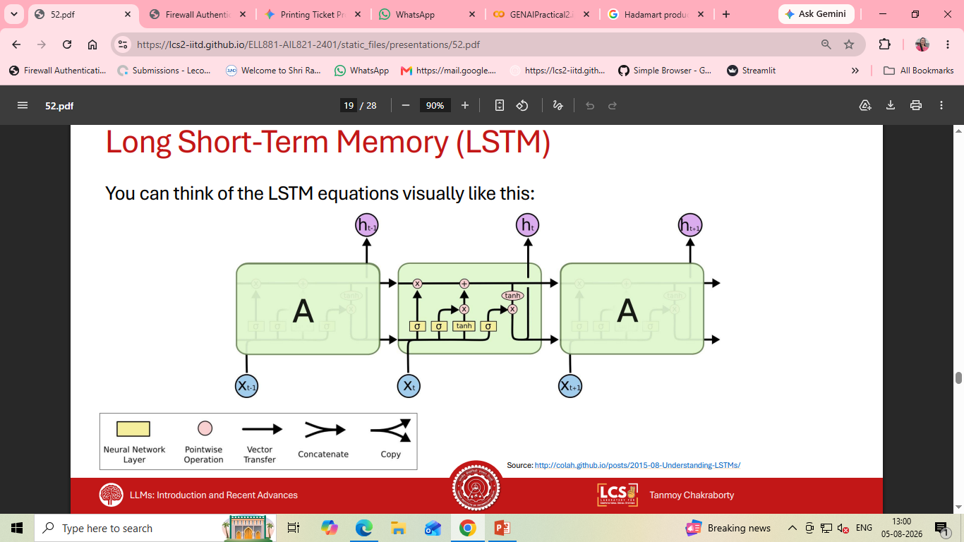
LSTM Architecture

Slide 60
LSTM
On a timestep t, given a sequence of tokens as input x^{(t)}, model will compute sequence of hidden states h^{(t)} and cell states c^{(t)}
Forget gate: controls what is kept vs forgotten from previous cell state
f^{(t)}=σ (W_{f}h^{(t-1)}+U_{f}x^{(t)}+b_{f})
Input gate: controls what parts of the new cell content are written to cell
i^{(t)}=σ (W_{i}h^{(t-1)}+U_{i}x^{(t)}+b_{i})
Output gate: controls what part of cell are output to hidden state
o^{(t)}=σ (W_{o}h^{(t-1)}+U_{o}x^{(t)}+b_{o})
σ Sigmoidal function

Slide 61
LSTM
Candidate cell state: this is the new content to be written to the cell
c^{~(t)} = tanh(W_{c}h^{(t-1)}+U_{c}x^{(t)}+b_{c})
Cell state: erase “forget” some content from last cell state, and write “input” some new cell content
c^{(t)} = f^{(t)}c^{(t-1)}+i^{(t)}c^{~(t)}
Hidden state: read “output” some content from the cell
h^{(t)} = o^{(t)}tanhc^{(t)}
Gates are applied using element-wise or Hadamart product: ⊙

Slide 62
Problem based on LSTM
Assume an LSTM cell with one unit with the following weights and biases:
Forget gate hidden-state weights: W_{f}=[0.1 0.2 0.3],
Forget gate input weights: U_{f}=[0.3 0.4 0.5],
Input gate hidden-state weigths: W_{i}=[0.5 0.6 0.7]
Input gate input weights: U_{i}=[0.6 0.7 0.8]
Output gate hidden-state weights: W_{o}=[0.7 0.8 0.9]
Output gate input weights: U_{o}=[0.8 0.9 0.7]
Cell state hidden-state weights: W_{c}=[0.4 0.6 0.5]
Cell state input weights: U_{c}=[0.3 0.4 0.5]
Biases: b_{f}=b_{i}=b_{o}=b_{c}=[0.1]

Slide 63
LSTM Cell Computation: At time step t=1 and input x⁽¹⁾=1, assume initial hidden state h⁽⁰⁾=[0 0 0] and cell state c⁽⁰⁾=[0]
Forget gate:
f⁽¹⁾=σ (W_{f}h⁽⁰⁾+U_{f}x⁽¹⁾+b_{f})
= σ([0.1 0.2 0.3].[0 0 0]+[0.3 0.4 0.5].[0 0 1]+[0.1])
= σ(0.6)=[0.645]
Input gate:
i⁽¹⁾=σ (W_{i}h⁽⁰⁾+U_{i}x⁽¹⁾+b_{i})
= σ([0.5 0.6 0.7].[0 0 0]+[0.6 0.7 0.8].[0 0 1]+[0.1])
= σ(0.9)=[0.711]
Output gate:
o^{(t)}=σ (W_{o}h⁽⁰⁾+U_{o}x⁽¹⁾+b_{o})
= σ([0.7 0.8 0.9].[0 0 0]+[0.8. 0.9.0.7].[0 0 1]+[0.1])
= σ(0.8)=[0.689]

Slide 64
Candidate cell state:
c^{~(1)} = tanh(W_{c}h⁽⁰⁾+U_{c}x⁽¹⁾+b_{c})
=tanh([0.4 0.6 0.5].[0 0 0]+[0.3 0.4 0.5].[0 0 1]+[0.1])
=tanh(0.6)=0.540
Cell state:
c⁽¹⁾ = f⁽¹⁾c⁽⁰⁾+i⁽¹⁾c^{~(1)}
= [0.645].[0]+[0.711].[0.537]
= [0.381]
Hidden state:
h⁽¹⁾ = o⁽¹⁾tanhc⁽¹⁾
= [0.689]tanh(0.381)
= [0.689].[0.364]
= [0.250]

Slide 65
Does LSTM Solves Vanishing Gradient Problem?
LSTM architecture makes it easier for an RNN to preserve many timesteps
E.g. if forget gate is set to 1 for a cell dimension and the input gate is set to 0 then information of that cell is preserved indefinitely.
Whereas vanilla RNN could not preserves information indefinitely.
LSTM doesn’t guarantee that there is no vanishing/ exploding gradient, but it does provide an easier way for the model to learn long-distance dependencies
Alternate methods are also available

Slide 66
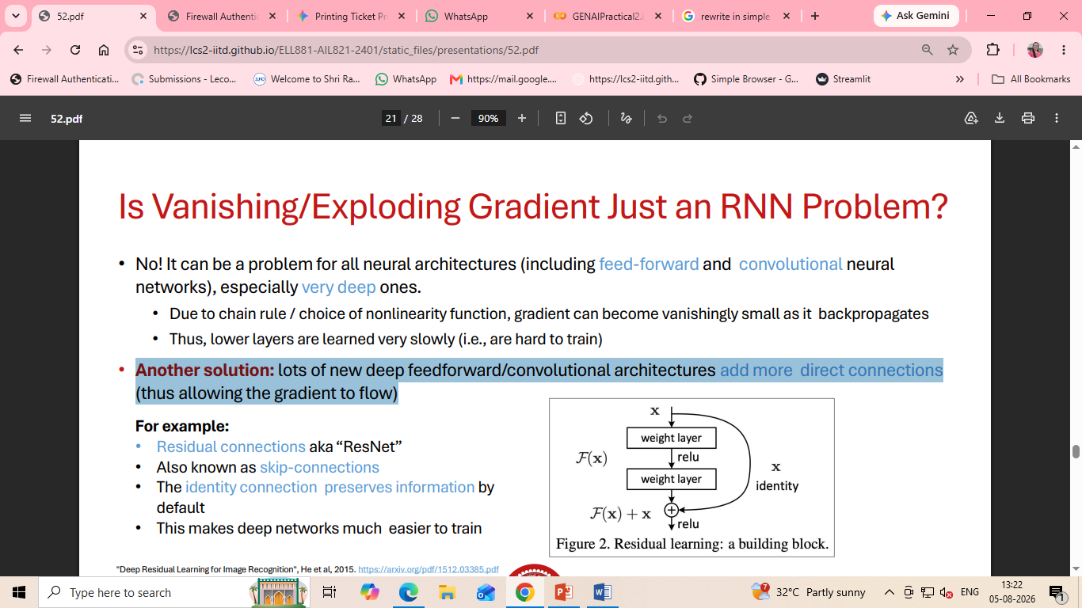
IS vanishing/exploding Gradient only an RNN problem?
It is a problem with all neural architectures including feed forward and CNN
Due to chain rule of nonlinearity function, gradient can become vanishingly small as it backpropagates
That is why, lower layers learn very slowly
Fix problem using new AI models use direct connections to help information flow better. E.g.
  Residual connections “RestNet”
  Skip-connections
  Identity connection preserves information by default

Slide 67
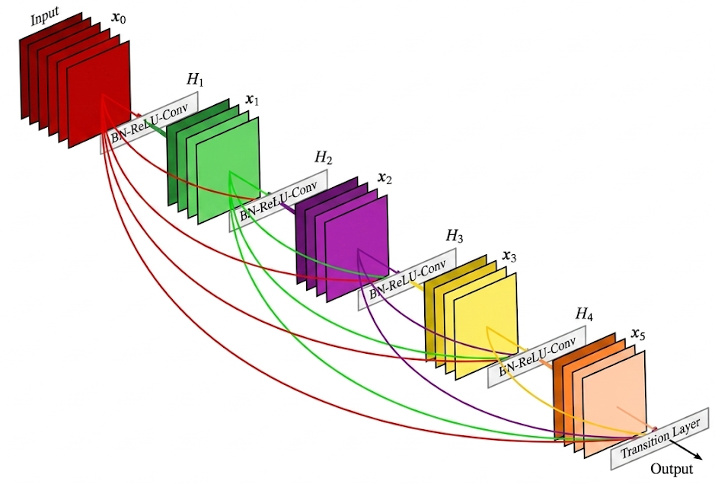
IS vanishing/exploding Gradient only an RNN problem?
Dense connections “DenseNet”
Directly connect each layer to all future layers
Figure shows five layer dense block with the growth rate of k=4. Each takes all preceding feature map as input

Slide 68
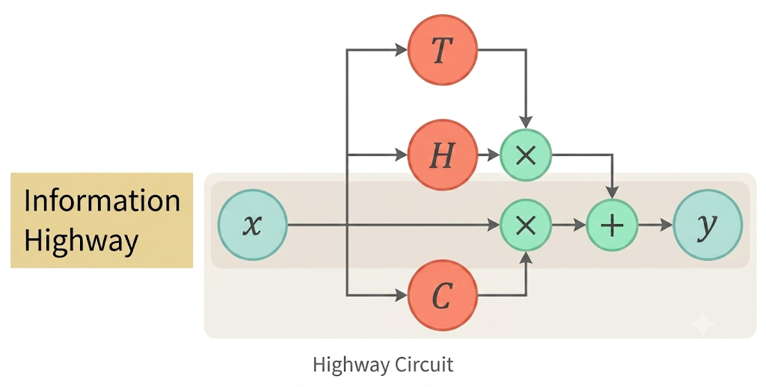
IS vanishing/exploding Gradient only an RNN problem?
Highway connections “HighwayNet”
Similar to residual connections, but the identity connection vs the transformation layer is controlled by a dynamic gate
Inspired by LSTMs, but applied to deep feedforward/ CNN

Slide 69
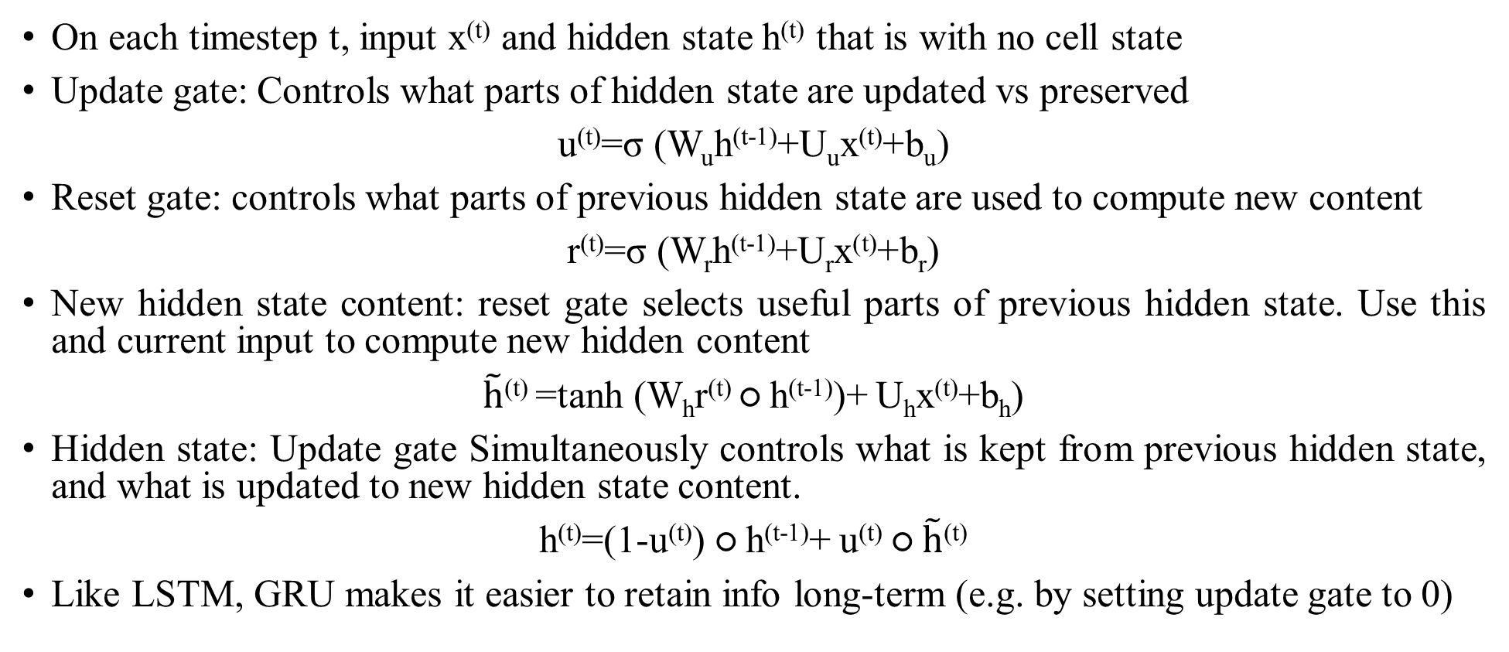
Gated Recurrent Units (GRU)
On each timestep t, input x^{(t)} and hidden state h^{(t)} that is with no cell state
Update gate: Controls what parts of hidden state are updated vs preserved
u^{(t)}=σ (W_{u}h^{(t-1)}+U_{u}x^{(t)}+b_{u})
Reset gate: controls what parts of previous hidden state are used to compute new content
r^{(t)}=σ (W_{r}h^{(t-1)}+U_{r}x^{(t)}+b_{r})
New hidden state content: reset gate selects useful parts of previous hidden state. Use this and current input to compute new hidden content
$\tilde{h}$^{(t)} =tanh (W_{h}r^{(t)} ○ h^{(t-1)})+ U_{h}x^{(t)}+b_{h})
Hidden state: Update gate Simultaneously controls what is kept from previous hidden state, and what is updated to new hidden state content.
h^{(t)}=(1-u^{(t)}) ○ h^{(t-1)}+ u^{(t)} ○ $\tilde{h}$^{(t)}
Like LSTM, GRU makes it easier to retain info long-term (e.g. by setting update gate to 0)

Slide 70
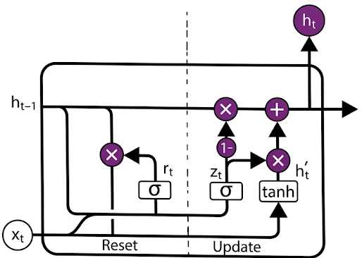
GRU Architecture

Slide 71
LSTM vs GRU
There are many gated RNN variants, but LSTM and GRU are the most widely-used.
Biggest difference is GRU is quicker to compute and has fewer parameters.
No conclusive evidence that one consistently performs better than the other.
LSTM is a good default choice especially if data has particularly long dependencies, or have lots of training data.
Rule of thumb: start with LSTM, but switch to GRU to have more efficient model

Slide 72
Encoder Decoder Architecture
Neural Machine translation task is performed using encoder decoder architecture
It involves two RNNs
Encoding of source sentence
Provides initial hidden state for decoder RNN

